Slide 1
MODFLOW Conceptual Models
CE EN 547 – BRIGHAM YOUNG UNIVERSITY

Slide 2
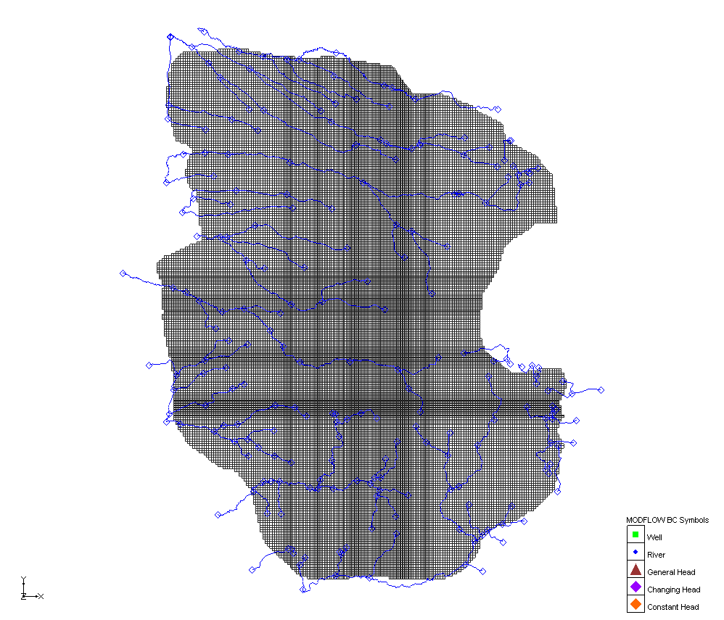
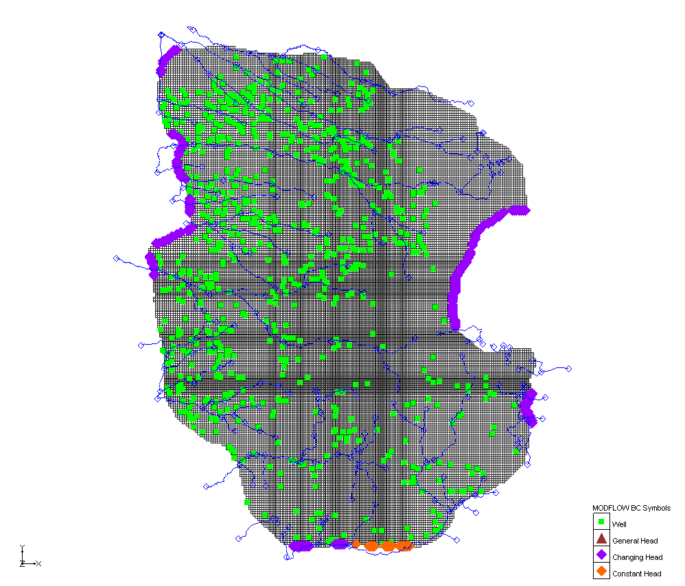
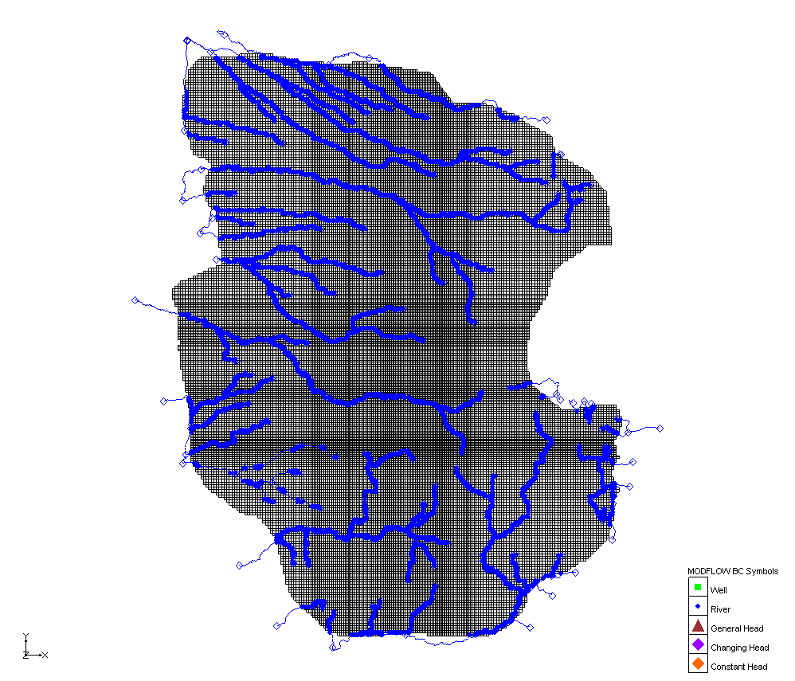
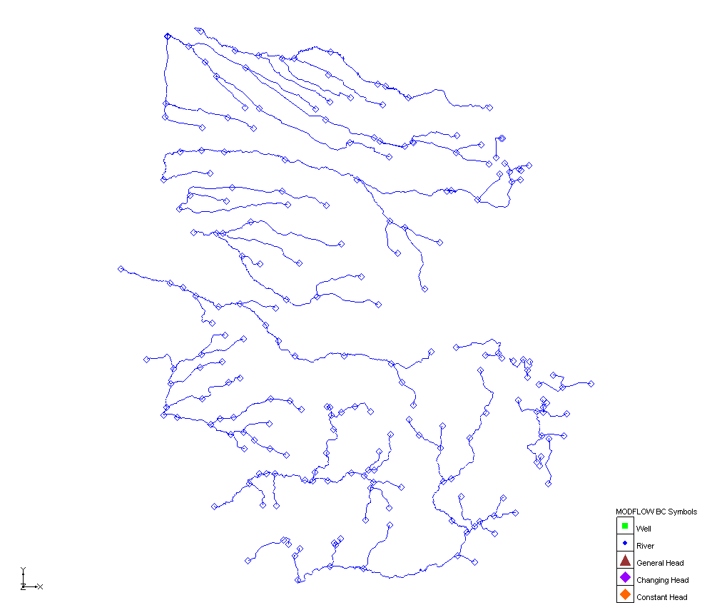

Slide 3
Steps
Build conceptual model object
Build coverages
Define grid frame
Build grid
Initialize MODFLOW
Activate cells in coverage
Map → MODFLOW

Slide 4
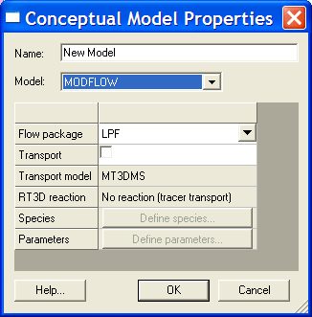
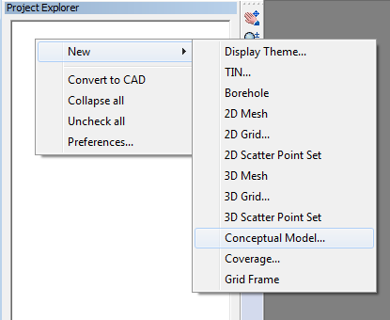
1. Build Conceptual Model Object
Used to organize conceptual model data
Defines flow package, transport option, species, etc.

Slide 5
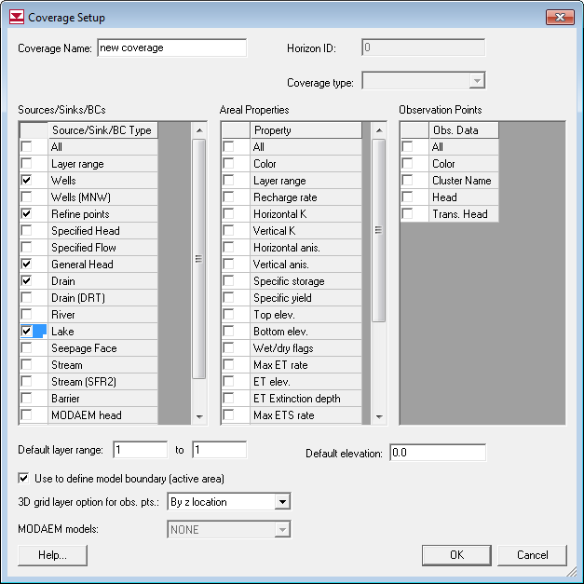
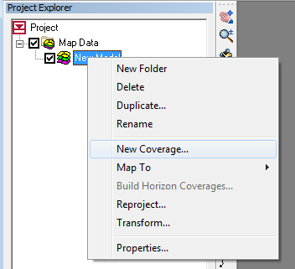
2. Build MODFLOW Coverages
Any combination of coverages can be used
Select desired properties

Slide 6
Conductances
Many of the objects in the Source/Sink category must be assigned a conductance value.
For arcs
  the conductance should be assigned on a conductance per length basis.
For polygons
  the conductance should be assigned on a conductance per area basis.
GMS computes length or area and computes and assigns the appropriate value.

Slide 7
Arc Conductance

Slide 8
Polygon Conductance

Slide 9
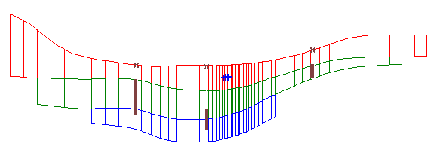
Well Screens
Elevations entered for well screen as part of well properties
Layers and partitioned Q automatically assigned

Slide 10
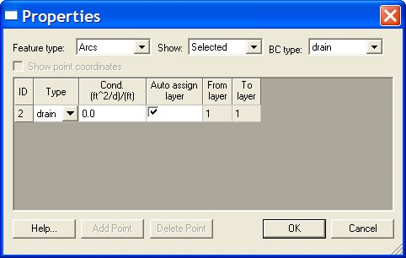
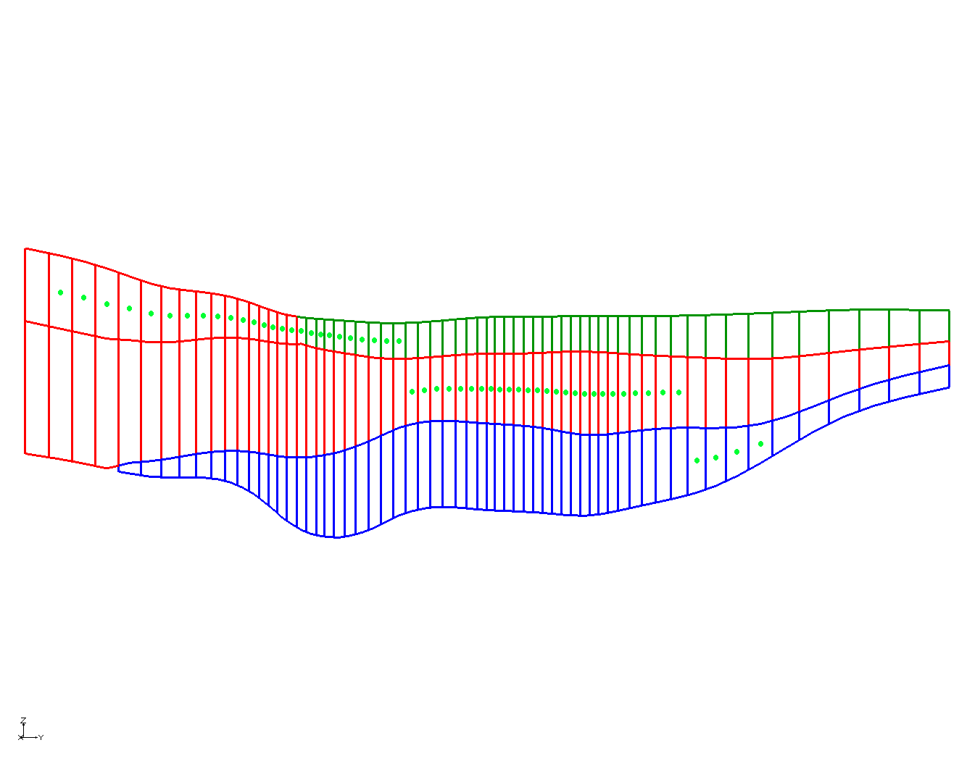
Auto Assign Elevations
Elevations entered at nodes as part of properties
Layers automatically assigned

Slide 11
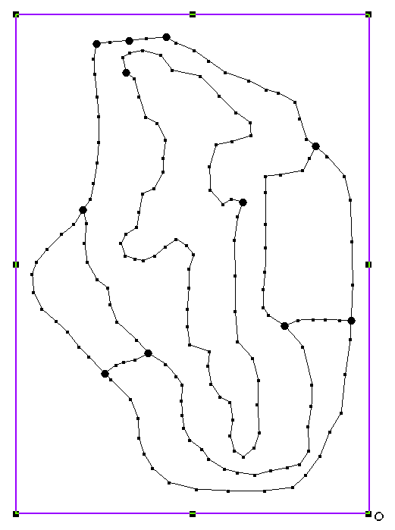
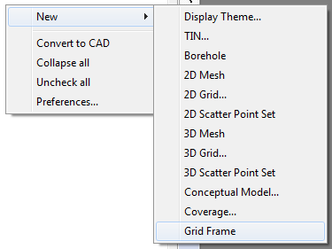
3. Grid Frame
Defines location of grid relative to conceptual model
Can be used to rotate the grid
  Use Grid Frame tool to edit

Slide 12
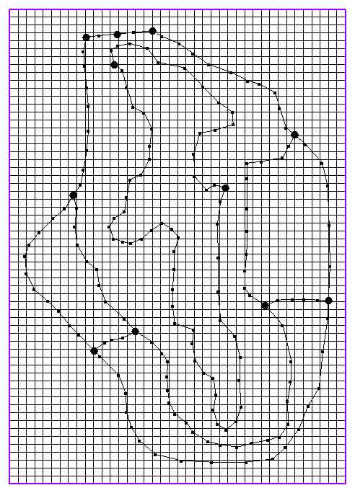
4. Build Grid
Select “Map → 3D Grid” command from Feature Object menu
Creates grid that fills grid frame

Slide 13
5. Initialize MODFLOW
Select “New Simulation” command in MODFLOW Menu in 3D Grid Module
Initializes MODFLOW data structures
Defines steady state vs. transient
Defines stress periods (if applicable)

Slide 14
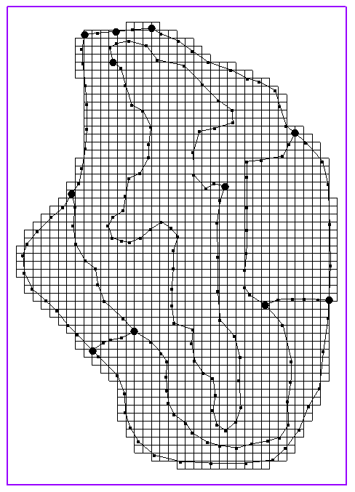
6. Activate Cells in Coverage
Select the “Activate Cells in Coverage(s)” command in Feature Objects menu
Inactivates all cells outside of conceptual model boundary

Slide 15
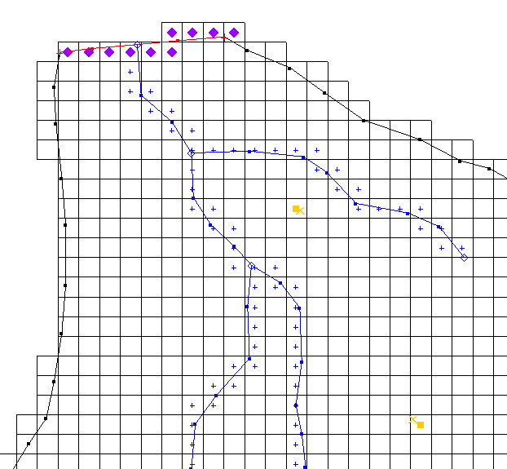
7. Map → MODFLOW
Select conceptual model in Project Explorer
Select the “Map → MODFLOW” command in Feature Objects menu
Discretizes model input

